Slide 1

UNIT – 1 INTRODUCTION TO NEURAL NETWORK
Final Year BTECH
Subject : Deep Learning (PE3)

Slide 2
Unit I : Contents
Introduction To Neural Network
Introduction, The architecture of an artificial neural network, Types of ANN architecture, Advantages and disadvantages of ANN, Perceptron, Sigmoid Neurons, Activation Functions, Loss Function.

Slide 3

Introduction, The architecture of an ANN, Types of ANN architecture, Advantages and Disadvantages of ANN
Sources:
https://www.javatpoint.com/artificial-neural-network
Introduction to Artificial Neural Systems by Jacek M. Zurada Yegnanarayana B, Artificial Neural Systems , PHP learning
Final Year BTECH
Subject : Deep Learning

Slide 4
What is Machine Learning?
Artificial Intelligence (AI) systems learn by extracting patterns from input and output data.
Machine Learning (ML) relies on learning patterns based on sample data. Programs learn from labeled data (supervised learning), unlabeled data (unsupervised learning), or a combination of both (semi-supervised learning).
Artificial Intelligence (AI) came around in the middle of 1900s when scientists tried to envision intelligent machines. Machine Learning evolved in the late 1900s. This allowed scientists to train machines for AI.
In the early 2000s, certain breakthroughs in multi-layered neural networks facilitated the advent of Deep Learning.

Slide 5
Deep Learning
DL –branch of ML, subset of AI
It is a type of machine learning that works based on the structure and function of the human brain.
Deep learning has gained massive popularity in scientific computing
Its algorithms are widely used by industries that solve complex problems.
All deep learning algorithms use different types of neural networks to perform specific tasks.
Deep learning uses artificial neural networks to perform sophisticated computations on large amounts of data.

Slide 6
Deep Learning
DL Models focus on accurate features by themselves
DL model needs less or little guidance from programmer
Useful in solving problem of dimensionality
DL is used when input and output are huge in nos

Slide 7
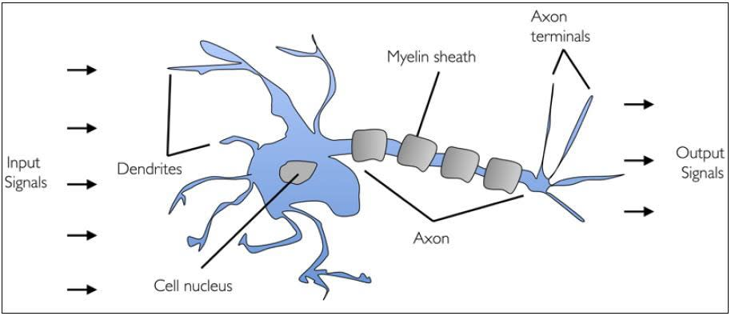
Introduction-ANN
Biological Neuron
A human brain has billions of neurons. Neurons are interconnected nerve cells in the human brain that are involved in processing and transmitting chemical and electrical signals. Dendrites are branches that receive information from other neurons.
Cell nucleus or Soma processes the information received from dendrites. Axon is a cable that is used by neurons to send information. Synapse is the connection between an axon and other neuron dendrites.

Slide 8
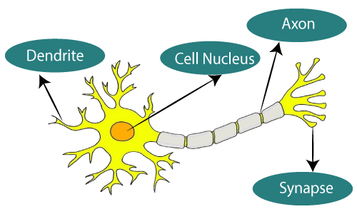
What is Artificial Neural Network?
The term "Artificial Neural Network" is derived from Biological neural networks that develop the structure of a human brain.
Similar to the human brain that has neurons interconnected to one another, artificial neural networks also have neurons that are interconnected to one another in various layers of the networks. These neurons are known as nodes.
The given figure illustrates the typical diagram of Biological Neural Network.
https://www.javatpoint.com/artificial-neural-network
Notes:
Reference:

Slide 9
Introduction-ANN
Researchers Warren McCullock and Walter Pitts published their first concept of simplified brain cell in 1943. This was called McCullock-Pitts (MCP) neuron. They described such a nerve cell as a simple logic gate with binary outputs.
Multiple signals arrive at the dendrites and are then integrated into the cell body, and, if the accumulated signal exceeds a certain threshold, an output signal is generated that will be passed on by the axon.
ANN in the field of AI where it attempts to mimic the network of neurons makes up a human brain so that computers will have an option to understand things and make decisions in a human-like manner.
It is designed by programming computers to behave simply like interconnected brain cells.
There are around 1000 billion neurons in the human brain. Each neuron has an association point somewhere in the range of 1,000 and 100,000.
Notes:
Reference:

Slide 10
Artificial Neuron
In the human brain, data is stored in such a manner as to be distributed, and we can extract more than one piece of this data when necessary from our memory parallelly.
Human brain is made up of incredibly amazing parallel processors.
A neuron is a mathematical function modeled on the working of biological neurons
It is an elementary unit in an artificial neural network
One or more inputs are separately weighted
Inputs are summed and passed through a nonlinear function to produce output
Every neuron holds an internal state called activation signal
Each connection link carries information about the input signal
Every neuron is connected to another neuron via connection link

Slide 11
What is Artificial Neural Network?
ANN example-
Consider an example of a digital logic gate that takes an input and gives an output. "OR" gate,
It takes two inputs. If one or both the inputs are "On," then we get "On" in output. If both the inputs are "Off," then we get "Off" in output.
Here the output depends upon input.
Our brain does not perform the same task. The outputs to inputs relationship keep changing because of the neurons in our brain, which are "learning."
Notes:
Reference:

Slide 12
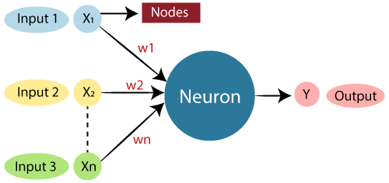
Relationship between Biological neural network and artificial neural network
Biological Neural Network | Artificial Neural Network
Dendrites | Inputs
Cell nucleus | Nodes
Synapse | Weights
Axon | Output
Table 1: Neural network (biological and artificial)

Slide 13
Typical Artificial Neural Network
The typical Artificial Neural Network looks something like the given figure.
Dendrites from Biological Neural Network represent inputs in Artificial Neural Networks, cell nucleus represents Nodes, synapse represents Weights, and Axon represents Output.
High level abstraction of neural input-output transformation
Inputs → weighted sum of inputs → nonlinear function → output

Slide 14
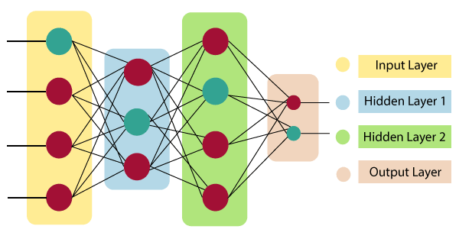
The architecture of an artificial neural network
In order to define a neural network that consists of a large number of artificial neurons, which are termed units arranged in a sequence of layers.
Fig 2 :Neural network’ different architectures
Notes:
Reference:

Slide 15
Layers of Artificial Neural Network
Input Layer:
As the name suggests, it accepts inputs in several different formats provided by the programmer.
Hidden Layer:
The hidden layer presents in-between input and output layers. It performs all the calculations to find hidden features and patterns.
Output Layer:
The input goes through a series of transformations using the hidden layer, which finally results in output that is conveyed using this layer.
Notes:
Reference:

Slide 16

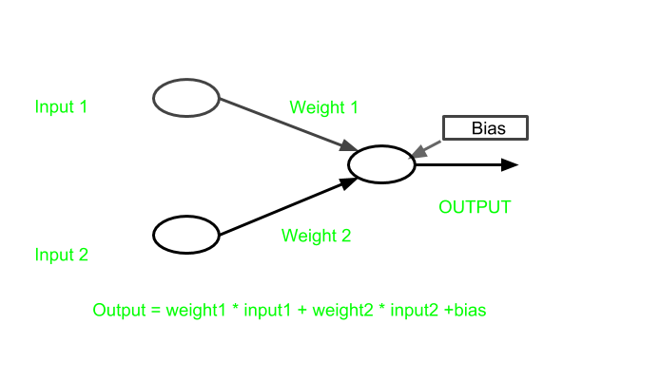

Slide 17
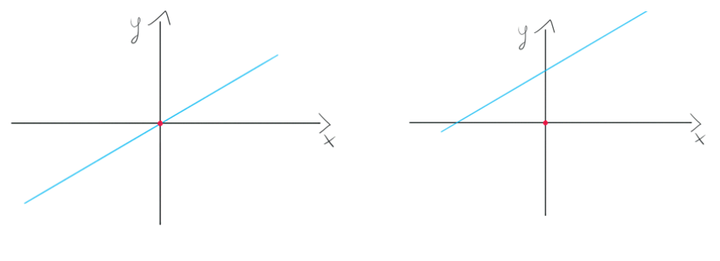
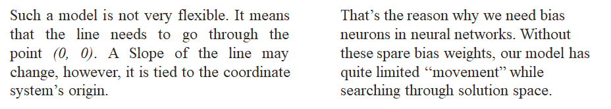
Need of Bais

Slide 18

Artificial Neural Network
The artificial neural network takes input and computes the weighted sum of the inputs and includes a bias. This computation is represented in the form of a transfer function.
It determines weighted total is passed as an input to an activation function to produce the output. Activation functions choose whether a node should fire or not. Only those who are fired make it to the output layer.
There are distinctive activation functions available that can be applied upon the sort of task we are performing.
Notes:
Reference:

Slide 19
Artificial Neural Network
Often used where data or functions are uncertain
Goal is to learn from a set of training data
And to generalize from learned instances to new unseen data
Key attributes
Parallel computation
Distributed representation and storage of data
Learning (networks adapt themselves to solve a problem)
Fault tolerance (insensitive to component failures)
Notes:
Reference:

Slide 20
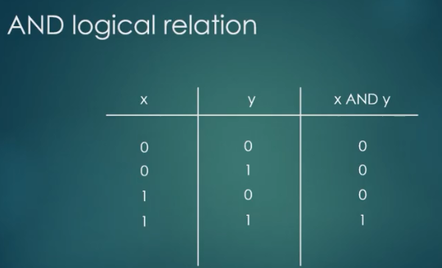
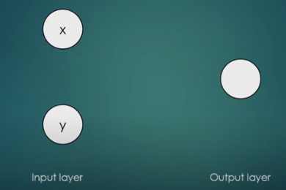
Artificial Neural Network
Notes:
Reference:

Slide 21
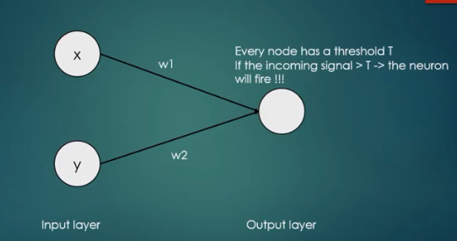
Artificial Neural Network
Notes:
Reference:

Slide 22
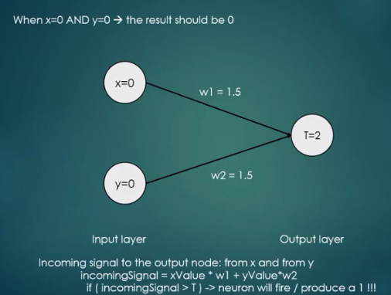
Artificial Neural Network
Notes:
Reference:

Slide 23
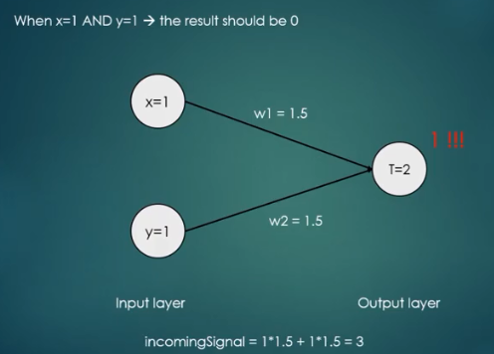
Artificial Neural Network
Notes:
Reference:

Slide 24
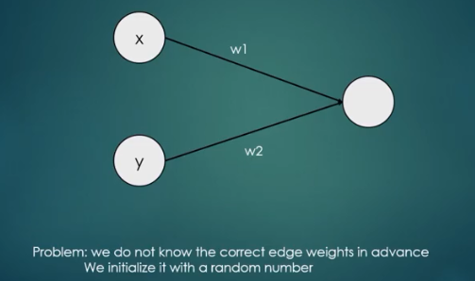
Artificial Neural Network
Notes:
Reference:

Slide 25
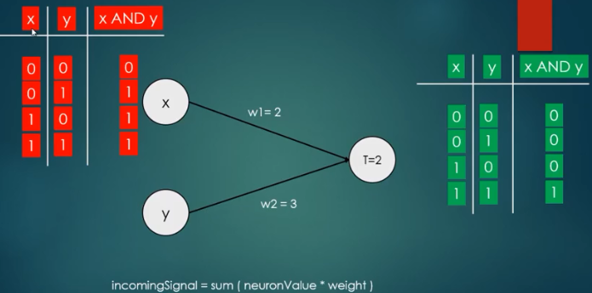
Artificial Neural Network
Notes:
Reference:

Slide 26
Types/Models of ANN Architecture
Feedforward Network
Feedback Network
Introduction to Artificial Neural Systems by Jacek M. Zurada Yegnanarayana B, Artificial Neural Systems , PHP learning. (Page no. 37)

Slide 27
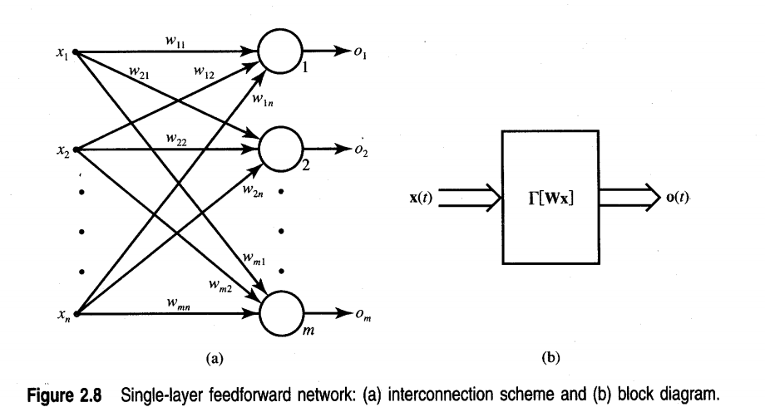
Types/Models of ANN Architecture
Feedforward Network
The generic feedforward network is characterized by the lack of feedback.
This type of network can be connected in cascade to create a multilayer network.
The output of a layer is the input to the following layer.
Even though the feedforward network has no explicit feedback connection when x(t) is mapped into o(t), the output values are often compared with the "teacher's" information, which provides the desired output value, and also an error signal can be employed for adapting the network's weights.
Introduction to Artificial Neural Systems by Jacek M. Zurada Yegnanarayana B, Artificial Neural Systems , PHP learning. (Page no. 37)

Slide 28
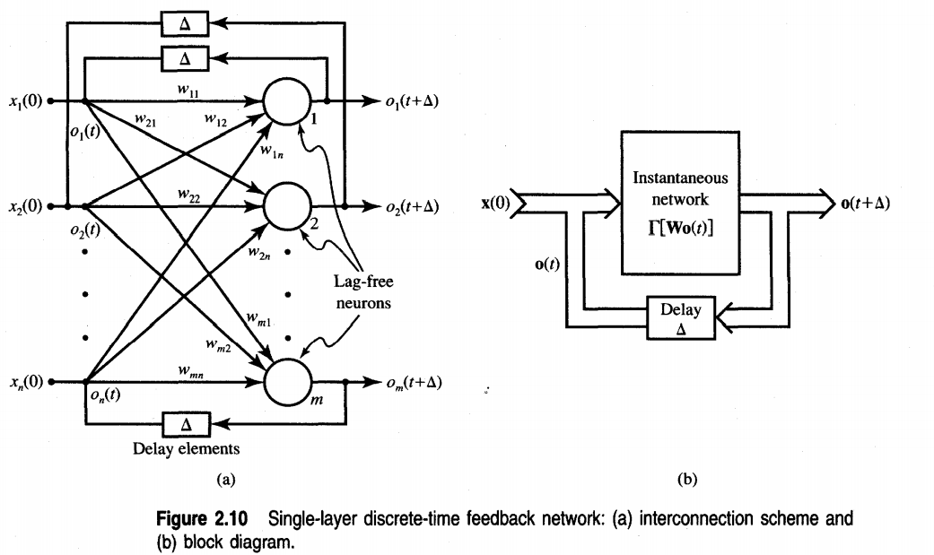
Types/Models of ANN Architecture
Feedback Network
A feedback network can be obtained from the feedforward network by connecting the neurons' outputs to their inputs.
Introduction to Artificial Neural Systems by Jacek M. Zurada Yegnanarayana B, Artificial Neural Systems , PHP learning. (Page no. 42)

Slide 29
Advantages of Artificial Neural Network (ANN)
Parallel processing capability:
Artificial neural networks have a numerical value that can perform more than one task simultaneously.
Storing data on the entire network:
Data that is used in traditional programming is stored on the whole network, not on a database. The disappearance of a couple of pieces of data in one place doesn't prevent the network from working.
Capability to work with incomplete knowledge:
After ANN training, the information may produce output even with inadequate data. The loss of performance here relies upon the significance of missing data.
Having a memory distribution:
For ANN is to be able to adapt, it is important to determine the examples and to encourage the network according to the desired output by demonstrating these examples to the network. The succession of the network is directly proportional to the chosen instances, and if the event can't appear to the network in all its aspects, it can produce false output.
Having fault tolerance:
Extortion of one or more cells of ANN does not prohibit it from generating output, and this feature makes the network fault-tolerance.
Notes:
Reference:

Slide 30
Disadvantages of Artificial Neural Network (ANN)
Assurance of proper network structure:
There is no particular guideline for determining the structure of artificial neural networks. The appropriate network structure is accomplished through experience, trial, and error.
Unrecognized behavior of the network:
It is the most significant issue of ANN. When ANN produces a testing solution, it does not provide insight concerning why and how. It decreases trust in the network.
Hardware dependence:
Artificial neural networks need processors with parallel processing power, as per their structure. Therefore, the realization of the equipment is dependent.
Difficulty of showing the issue to the network:
ANNs can work with numerical data. Problems must be converted into numerical values before being introduced to ANN. The presentation mechanism to be resolved here will directly impact the performance of the network. It relies on the user's abilities.
The duration of the network is unknown:
The network is reduced to a specific value of the error, and this value does not give us optimum results.
Notes:
Reference:

Slide 31

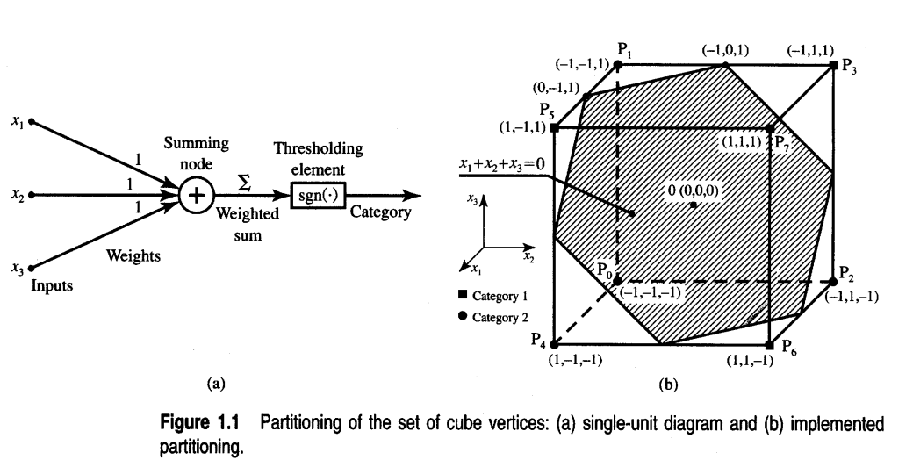
1.1 Neural Computation (With Example)
To inspect the performance of a simple classifier-
Set of eight points, Po, P1, . . . , P7, in three-dimensional space is available.
The set consists of all vertices of a three-dimensional cube as follows:
Introduction to Artificial Neural Systems by Jacek M. Zurada Yegnanarayana B, Artificial Neural Systems , PHP learning. (Page no. 3-8)
Notes:
Reference:

Slide 32

1.1 Neural Computation (With Example)
Elements of this set need to be classified into two categories.
The first category is defined as containing points with two or more positive ones
The second category contains all the remaining points that do not belong to the first category.
Accordingly, points P3, P5, P6, and P7 belong to the first category
Remaining points to the second category. Classification of points P3, P5, P6, and P7 can be based on the summation of coordinate values for each point evaluated for category membership.
For each point Pi (x,, x2, x3), where i = 0, . . . , 7, the membership in the category can be established by the following calculation:
Describes the decision function of the classifier designed by inspection of the set that needs to be partitioned
Introduction to Artificial Neural Systems by Jacek M. Zurada Yegnanarayana B, Artificial Neural Systems , PHP learning. (Page no. 3-8)
Notes:
Reference:

Slide 33
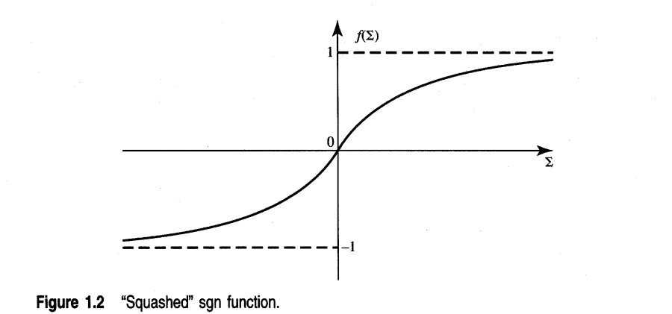
1.1 Neural Computation (With Example)
The unit from below Figure maps the entire three-dimensional space into just two points, 1 and - 1.
A question arises as to whether a unit with a "squashed" sgn function rather than a regular sgn function could prove more advantageous.
Assuming that the "squashed" sgn function has the shape as in Figure, the outputs take values in the range (- 1,l) and are generally more discernible than in the previous case.
Using units with continuous characteristics offers tremendous opportunities for new tasks that can be performed by neural networks. Specifically, the fine granularity of output provides more information than the binary f 1 output of the thresholding element.
Introduction to Artificial Neural Systems by Jacek M. Zurada Yegnanarayana B, Artificial Neural Systems , PHP learning. (Page no. 3-8)
Notes:
Reference:

Slide 34
Perceptron, Sigmoid Neurons
Sources:
1. Michael A. Nielsen, "Neural Networks and Deep Learning", Determination Press, 2015 (Module I- Perceptron, Sigmoid Neurons)
2. https://www.simplilearn.com/what-is-perceptron-tutorial
Final Year BTECH
Subject : Deep Learning (PE3)

Slide 35
Perceptron
A perceptron is a neural network unit (an artificial neuron) that does certain computations to detect features or business intelligence in the input data.
A type of artificial neuron called a perceptron.
Perceptron was introduced by Frank Rosenblatt in 1957. He proposed a Perceptron learning rule based on the original MCP neuron.
A Perceptron is an algorithm for supervised learning of binary classifiers. This algorithm enables neurons to learn and processes elements in the training set one at a time.
Michael A. Nielsen, "Neural Networks and Deep Learning", Determination Press, 2015 (Module I- Perceptron, Sigmoid Neurons)

Slide 36
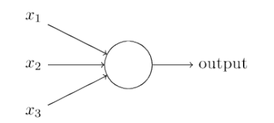


How do perceptron's work?
A perceptron takes several binary inputs, x1 , x2 , . . ., and produces a single binary output
In the example shown the perceptron has three inputs, x1 , x2 , x3 . In general it could have more or fewer inputs
Rosenblatt proposed a simple rule to compute the output. He introduced weights, w1 ,w2 , . . ., real numbers expressing the importance of the respective inputs to the output.
The neuron’s output, 0 or 1, is determined by whether the weighted sum is less than or greater than some threshold value
Just like the weights, the threshold is a real number which is a parameter of the neuron. To put it in more precise algebraic terms
$$\sum_{j}{WjXj}$$

Slide 37
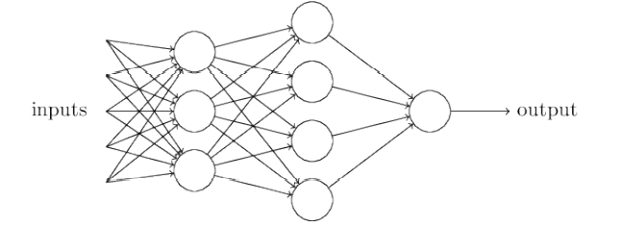
Perceptron
The first column of perceptron's – the first layer of perceptrons – is making three very simple decisions, by weighing the input evidence.
Perceptrons in the second layer- Each of those perceptron's is making a decision by weighing up the results from the first layer of decision-making.
Perceptron in the second layer can make a decision at a more complex and more abstract level than perceptron's in the first layer.
And even more complex decisions can be made by the perceptron in the third layer.
A many-layer network of perceptron's can engage in sophisticated decision making.

Slide 38
Perceptron
There are two types of Perceptrons: Single layer and Multilayer.
Single layer Perceptrons can learn only linearly separable patterns.
Multilayer Perceptrons or feedforward neural networks with two or more layers have the greater processing power.
The Perceptron algorithm learns the weights for the input signals in order to draw a linear decision boundary.
This enables you to distinguish between the two linearly separable classes +1 and -1.
Supervised Learning is a type of Machine Learning used to learn models from labeled training data. It enables output prediction for future or unseen data.
https://www.simplilearn.com/what-is-perceptron-tutorial

Slide 39
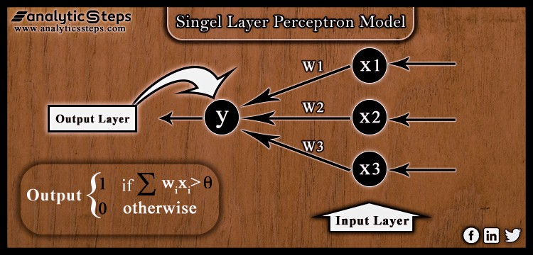
Perceptron-Single layer
It includes a feed-forward network depends on a threshold transfer function in its model.
It is the easiest type of ANN that able to analyze only linearly separable objects with binary outcomes(target) i.e. 1, and 0.

Slide 40
Perceptron-Single layer
In single-layered perceptron model, its algorithm doesn’t have previous information,
Initially, weights are allocated inconstantly, then the algorithm adds up all the weighted inputs, if the added value is more than some pre-determined value( or, threshold value) then single-layered perceptron is stated as activated and delivered output as +1.
Multiple input values feed up to the perceptron model, model executes with input values, and if the estimated value is the same as the required output, then the model performance is found out to be satisfied, therefore weights demand no changes. In fact, if the model doesn’t meet the required result then few changes are made up in weights to minimize errors.

Slide 41
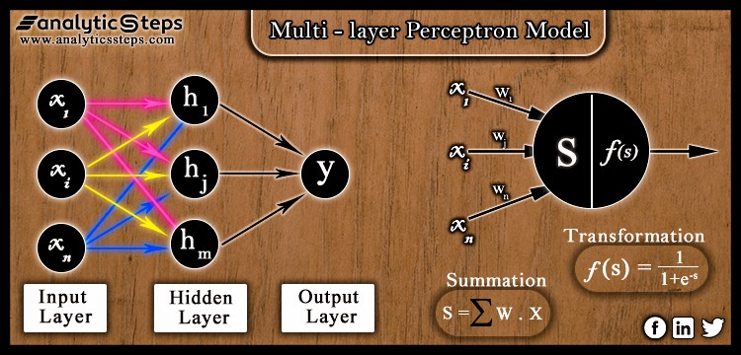
Perceptron-Multi layer
It has a structure similar to a single-layered perceptron model with more number of hidden layers.
It is also termed as a Backpropagation algorithm. It executes in two stages; the forward stage and the backward stages.

Slide 42
Perceptron-Multilayer
In the forward stage, activation functions are originated from the input layer to the output layer,
In the backward stage, the error between the actual observed value and demanded given value is originated backward in the output layer for modifying weights and bias values.
In simple terms, multi-layered perceptron can be treated as a network of numerous artificial neurons overhead varied layers, the activation function is no longer linear, instead, non-linear activation functions such as Sigmoid functions, TanH, ReLU activation Functions, etc are deployed for execution.

Slide 43
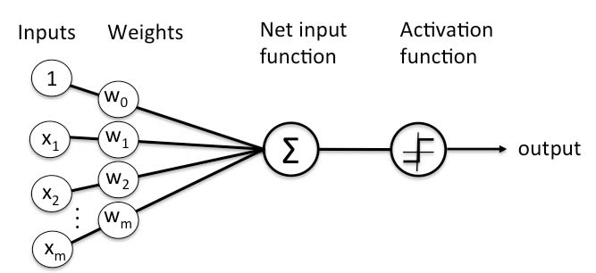
Perceptron

Slide 44
Perceptron Learning Rule
Perceptron Learning Rule states that the algorithm would automatically learn the optimal weight coefficients.
The input features are then multiplied with these weights to determine if a neuron fires or not.
The Perceptron receives multiple input signals, and if the sum of the input signals exceeds a certain threshold, it either outputs a signal or does not return an output.
In the context of supervised learning and classification, this can then be used to predict the class of a sample.

Slide 45
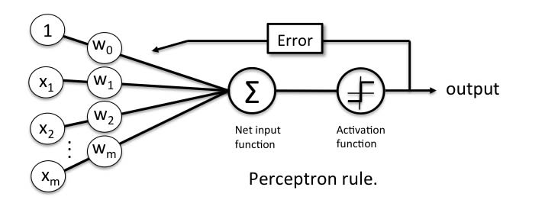
Perceptron Learning Rule

Slide 46


Perceptron Function
Perceptron is a function that maps its input “x,” which is multiplied with the learned weight coefficient; an output value ”f(x)”is generated.
In the equation given above:
“w” = vector of real-valued weights
“b” = bias (an element that adjusts the boundary away from origin without any dependence on the input value)
“x” = vector of input x values
“m” = number of inputs to the Perceptron
The output can be represented as “1” or “0.” It can also be represented as “1” or “-1” depending on which activation function is used.

Slide 47
Inputs of a Perceptron
A Perceptron accepts inputs, moderates them with certain weight values, then applies the transformation function to output the final result
A Boolean output is based on inputs such as salaried, married, age, past credit profile, etc. It has only two values: Yes and No or True and False.
The summation function “∑” multiplies all inputs of “x” by weights “w” and then adds them up as follows:

Slide 48
Inputs of a Perceptron

Slide 49
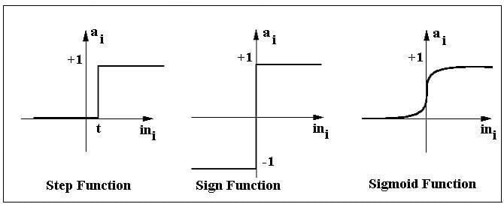
Activation Functions of Perceptron
The activation function applies a step rule (convert the numerical output into +1 or -1) to check if the output of the weighting function is greater than zero or not.

Slide 50
Activation Functions of Perceptron
E.g.
If ∑ wixi> 0 => then final output “o” = 1 (issue bank loan)
Else, final output “o” = -1 (deny bank loan)
Step function gets triggered above a certain value of the neuron output; else it outputs zero. Sign Function outputs +1 or -1 depending on whether neuron output is greater than zero or not. Sigmoid is the S-curve and outputs a value between 0 and 1.

Slide 51

Output of Perceptron
Perceptron with a Boolean output:
Inputs: x1…xn
Output: o(x1….xn)
Weights: wi=> contribution of input xi to the Perceptron output;
w0=> bias or threshold
If ∑w.x > 0, output is +1, else -1. The neuron gets triggered only when weighted input reaches a certain threshold value.

Slide 52
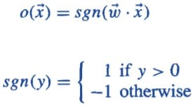
Output of Perceptron
An output of +1 specifies that the neuron is triggered. An output of -1 specifies that the neuron did not get triggered.
“sgn” stands for sign function with output +1 or -1.

Slide 53
Error in Perceptron
In the Perceptron Learning Rule, the predicted output is compared with the known output. If it does not match, the error is propagated backward to allow weight adjustment to happen.

Slide 54
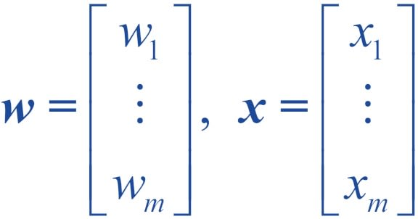

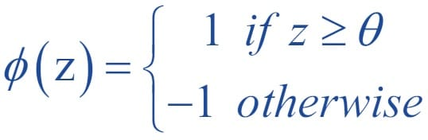
Perceptron: Decision Function
A decision function φ(z) of Perceptron is defined to take a linear combination of x and w vectors.
The value z in the decision function is given by:
The decision function is +1 if z is greater than a threshold θ, and it is -1 otherwise.

Slide 55
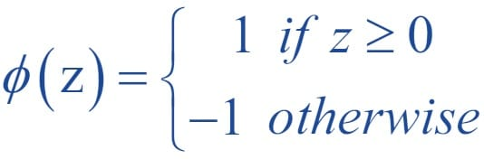
Perceptron: Decision Function
Bias Unit
For simplicity, the threshold θ can be brought to the left and represented as w0x0, where w0= -θ and x0= 1.
The value w0 is called the bias unit.
The decision function then becomes:

Slide 56
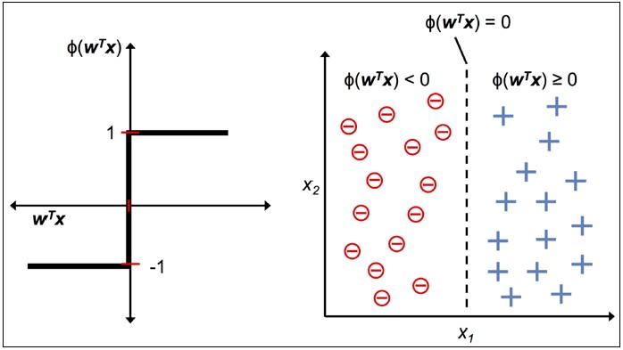
Perceptron: Decision Function
Output
The figure shows how the decision function squashes wTx to either +1 or -1 and how it can be used to discriminate between two linearly separable classes.

Slide 57
Perceptron
Perceptron has the following characteristics:
Perceptron is an algorithm for Supervised Learning of single layer binary linear classifier.
Optimal weight coefficients are automatically learned.
Weights are multiplied with the input features and decision is made if the neuron is fired or not.
Activation function applies a step rule to check if the output of the weighting function is greater than zero.
Linear decision boundary is drawn enabling the distinction between the two linearly separable classes +1 and -1.
If the sum of the input signals exceeds a certain threshold, it outputs a signal; otherwise, there is no output.
Types of activation functions include the sign, step, and sigmoid functions.

Slide 58
Summary Perceptron
The activation function to be used is a subjective decision based on the problem statement and the form of the desired results.
If the learning process is slow or has vanishing or exploding gradients, change the activation function to see if these problems can be resolved.
An artificial neuron is a mathematical function conceived as a model of biological neurons, that is, a neural network.
A Perceptron is a neural network unit that does certain computations to detect features or business intelligence in the input data. It is a function that maps its input “x,” which is multiplied by the learned weight coefficient, and generates an output value ”f(x).
”Perceptron Learning Rule states that the algorithm would automatically learn the optimal weight coefficients.
Single layer Perceptrons can learn only linearly separable patterns.
Multilayer Perceptron or feedforward neural network with two or more layers have the greater processing power and can process non-linear patterns as well.
Perceptrons can implement Logic Gates like AND, OR, or XOR.

Slide 59
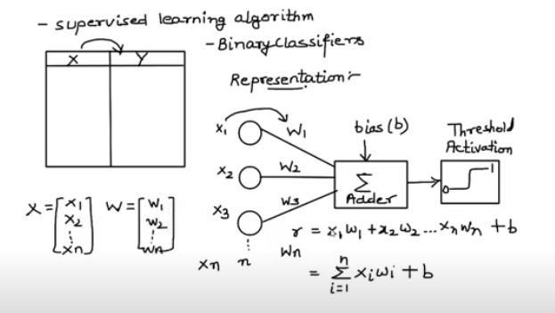
Perceptron
Michael A. Nielsen, "Neural Networks and Deep Learning", Determination Press, 2015 (Module I- Perceptron, Sigmoid Neurons)

Slide 60
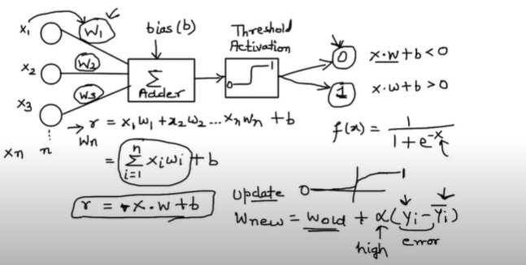
Perceptron
Michael A. Nielsen, "Neural Networks and Deep Learning", Determination Press, 2015 (Module I- Perceptron, Sigmoid Neurons)

Slide 61
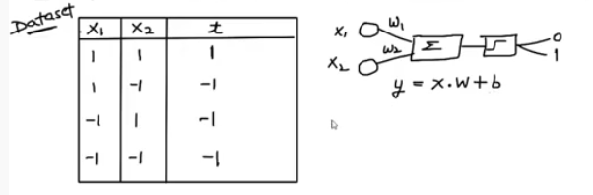
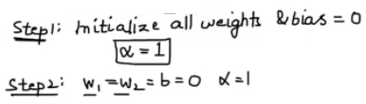

Perceptron Example : Implementation AND function using Perceptron Network for bipolar input (1,-1 ) and target
Iteration 1
Michael A. Nielsen, "Neural Networks and Deep Learning", Determination Press, 2015 (Module I- Perceptron, Sigmoid Neurons)

Slide 62
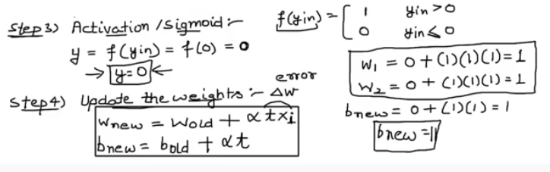
Perceptron Example : Implementation AND function using Perceptron Network for bipolar input (1,-1 ) and target
Michael A. Nielsen, "Neural Networks and Deep Learning", Determination Press, 2015 (Module I- Perceptron, Sigmoid Neurons)

Slide 63
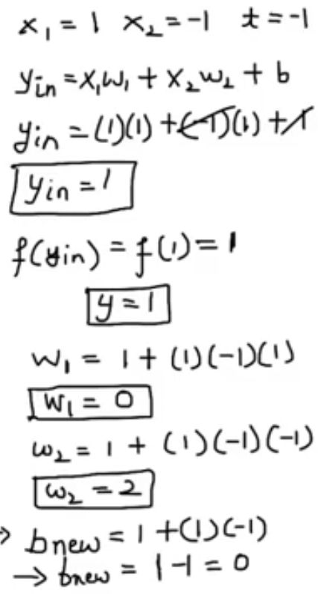
Perceptron Example : Implementation AND function using Perceptron Network for bipolar input (1,-1 ) and target
Iteration 2
Michael A. Nielsen, "Neural Networks and Deep Learning", Determination Press, 2015 (Module I- Perceptron, Sigmoid Neurons)

Slide 64
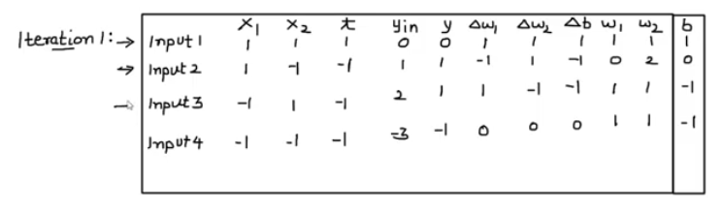
Perceptron Example : Implementation AND function using Perceptron Network for bipolar input (1,-1 ) and target
Iteration 2 – Home work
Michael A. Nielsen, "Neural Networks and Deep Learning", Determination Press, 2015 (Module I- Perceptron, Sigmoid Neurons)

Slide 65
Sigmoid Neuron
Sigmoid neurons are the building block of the deep neural networks.
Sigmoid neurons are similar to perceptrons, but they are slightly modified such that the output from the sigmoid neuron is much smoother than the step functional output from perceptron.
https://towardsdatascience.com/sigmoid-neuron-deep-neural-networks-a4cd35b629d7

Slide 66
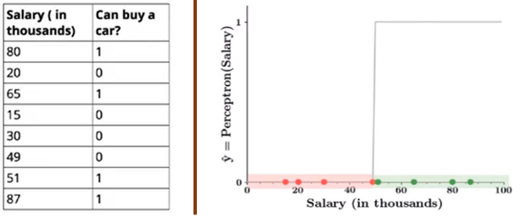
Why Sigmoid Neuron
Consider the decision making process of a person, whether he/she would like to purchase a car or not based on only one input X1 — Salary and by setting the threshold b(Wₒ) = -10 and the weight W₁ = 0.2.
The output from the perceptron model will look like in the figure shown below.
Notes:
Red points indicates that a person would not buy a car and green points indicate that person would like to buy a car. Isn’t it a bit odd that a person with 50.1K will buy a car but someone with a 49.9K will not buy a car? The small change in the input to a perceptron can sometimes cause the output to completely flip, say from 0 to 1. This behavior is not a characteristic of the specific problem we choose or the specific weight and the threshold we choose. It is a characteristic of the perceptron neuron itself which behaves like a step function. We can overcome this problem by introducing a new type of artificial neuron called a sigmoid neuron.

Slide 67
Why Sigmoid Neuron
Perceptron model takes several real-valued inputs and gives a single binary output.
In the perceptron model, every input xi has weight wi associated with it.
The weights indicate the importance of the input in the decision-making process.
The model output is decided by a threshold Wₒ if the weighted sum of the inputs is greater than threshold Wₒ output will be 1 else output will be 0.
In other words, the model will fire if the weighted sum is greater than the threshold.

Slide 68
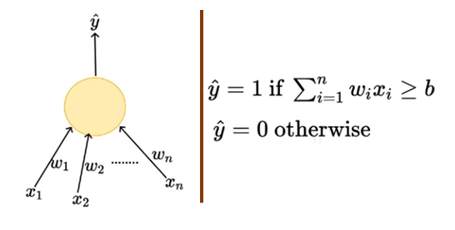
Why Sigmoid Neuron
From the mathematical representation, we might say that the thresholding logic used by the perceptron is very harsh

Slide 69
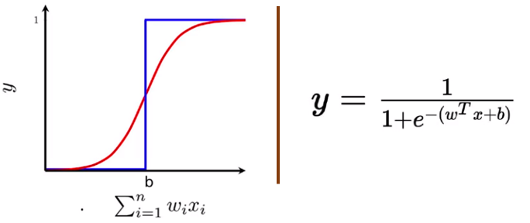
Sigmoid Neuron
In sigmoid neurons where the output function is much smoother than the step function.
In the sigmoid neuron, a small change in the input only causes a small change in the output as opposed to the stepped output.
There are many functions with the characteristic of an “S” shaped curve known as sigmoid functions. The most commonly used function is the logistic function.
Notes:
no longer see a sharp transition at the threshold b. The output from the sigmoid neuron is not 0 or 1. Instead, it is a real value between 0–1 which can be interpreted as a probability

Slide 70
Sigmoid Neuron
The inputs to the sigmoid neuron can be real numbers unlike the boolean inputs in MP Neuron and the output will also be a real number between 0–1.
In the sigmoid neuron, trying to regress the relationship between X and Y in terms of probability.
Even though the output is between 0–1, we can still use the sigmoid function for binary classification tasks by choosing some threshold.

Slide 71
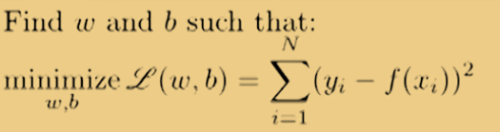
Sigmoid Neuron
Learning Algorithm
algorithm for learning the parameters w and b of the sigmoid neuron model by using the gradient descent algorithm.
The objective of the learning algorithm is to determine the best possible values for the parameters, such that the overall loss (squared error loss) of the model is minimized as much as possible.

Slide 72
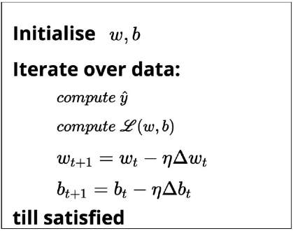
Sigmoid Neuron

Slide 73

Sigmoid Neuron
Initialize w and b randomly
Iterate over all the observations in the data, for each observation find the corresponding predicted outcome using the sigmoid function
Compute the squared error loss.
Based on the loss value, update the weights such that the overall loss of the model at the new parameters will be less than the current loss of the model.
Loss optimization

Slide 74
Activation Functions, Loss Function
Sources:
https://towardsdatascience.com/activation-functions-neural-networks-1cbd9f8d91d6
https://medium.com/@abhigoku10/activation-functions-and-its-types-in-artifical-neural-network-14511f3080a8
https://medium.com/@zeeshanmulla/cost-activation-loss-function-neural-network-deep-learning-what-are-these-91167825a4de
https://towardsdatascience.com/deep-learning-which-loss-and-activation-functions-should-i-use-ac02f1c56aa8
Final Year BTECH
Subject : Deep Learning (PE3)

Slide 75
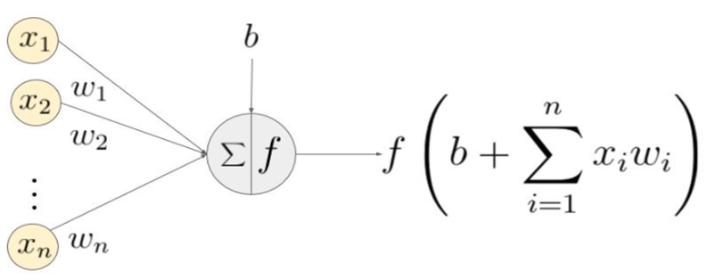
A Simple Neural Network
A Neuron [2]:
(x₁,x₂, …x_{n}) - input signal vector
(w₁,w₂,…w_{n}) - weights
accumulation ( i.e. summation + addition of bias b)
an activation function f is applied to this sum
https://medium.com/@abhigoku10/activation-functions-and-its-types-in-artifical-neural-network-14511f3080a8

Slide 76
Activation Function
An activation function is a very important feature of an Artificial Neural Network to learn and understand the complex patterns
A mathematical equation that determine the output of node
It helps to normalize the output of each neuron to a range between 1 and 0 or between -1 and 1
It is also known as Transfer Function

Slide 77
Activation Function
The function
attached to each neuron in the network
determines whether neuron should be activated (“fired”) or not,
based on whether each neuron’s input is relevant for the model’s prediction
Computationally efficient (calculated across thousands/millions of neurons for each data sample)
The need for speed has led to the development of new functions such as ReLu

Slide 78
Activation Function (Types)
The Activation Functions [1] can be basically divided into 2 types-
Linear Activation Function
Non-linear Activation Functions
https://medium.com/@abhigoku10/activation-functions-and-its-types-in-artifical-neural-network-14511f3080a8

Slide 79
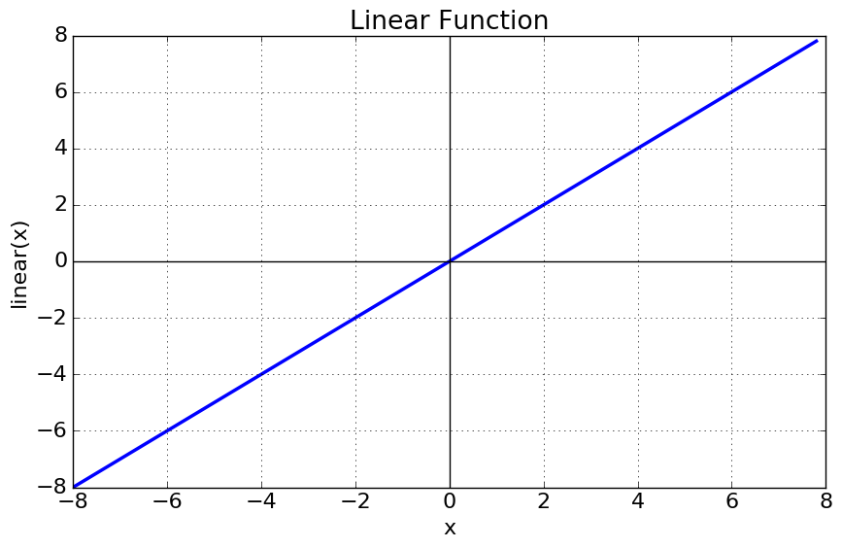
Activation Function (Linear)
Linear Activation Function:
Equation : f(x) = x
Range : (-infinity to infinity)
It doesn’t help with the complex data

Slide 80
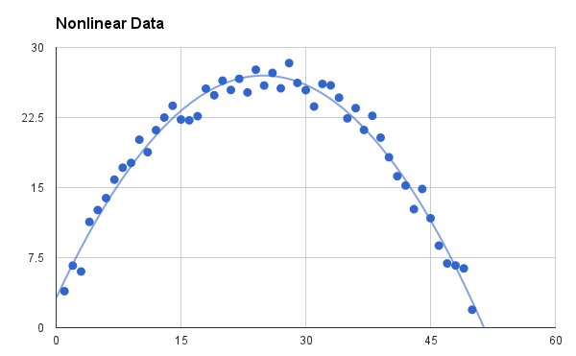
Activation Function (Non-Linear)
Non-linear Activation Functions
The model generalizes or adapts with variety of data (images, video, audio, and have high dimensionality)
It allows backpropagation (derivative function which is related to the inputs)
Create a deep neural network (“stacking” of multiple layers of neurons)

Slide 81
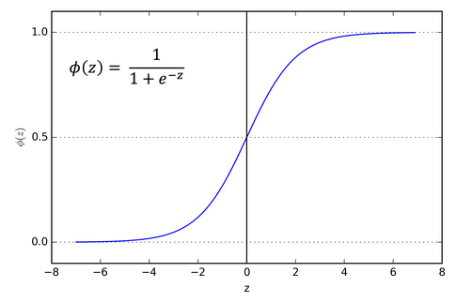
Activation Function (Non-Linear)
The Nonlinear Activation Functions are mainly divided on the basis of their range or curves
Sigmoid or Logistic Activation Function
A S-shape curve
Predict the probability
(0 and 1)
N/W can stuck at the
training time

Slide 82
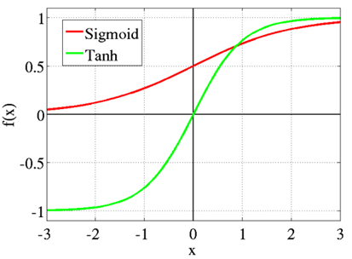
Activation Function (Non-Linear)
Tanh or hyperbolic tangent Activation Function
tanh is also sigmoidal (S - shaped) with range -1 to 1
the negative inputs will also be mapped
Mostly tanh &logistic sigmoid are used in feed-forward n/w

Slide 83
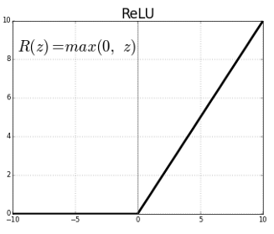
Activation Function (Non-Linear)
ReLU (Rectified Linear Unit) Activation Function
Widely used function (DL and CNN)
ReLU is half rectified (from bottom)
f(z) is zero when z is less than zero
f(z) is equal to z when z is above or equal to zero

Slide 84
Activation Function (Non-Linear)
ReLU Advantages
Computationally efficient—allows the network to converge very quickly
Non-linear—although it looks like a linear function, ReLU has a derivative function and allows for backpropagation
Disadvantages
The Dying ReLU problem—when inputs approach zero, or are negative, the gradient of the function becomes zero, the network cannot perform backpropagation and cannot learn

Slide 85
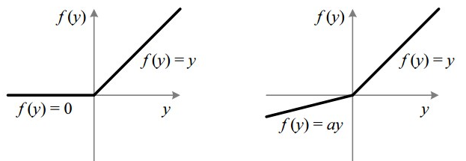
Activation Function (Non-Linear)
Leaky ReLU
Attempt to solve the dying ReLU problem (a small positive slope in the negative area enables backpropagation)
The leak helps to increase the range of the ReLU function
f(x) = ax for x<0 and f(x) = x for x>0
Range : (0.01 to infinity)
When a is not 0.01 then it is called Randomized ReLU.

Slide 86
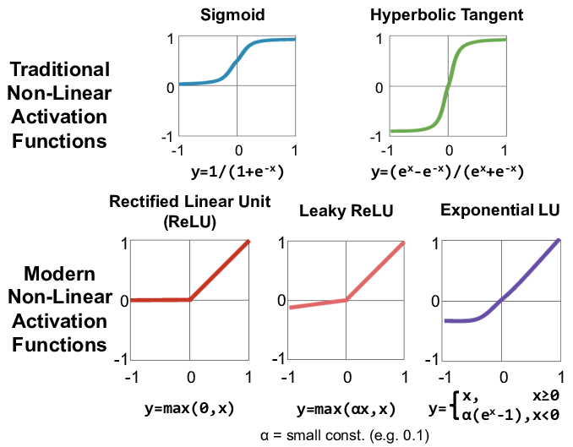
Activation Function (Non-Linear)
Src: Sze, Vivienne & Chen, Yu-Hsin & Yang, Tien-Ju & Emer, Joel. (2017). Efficient Processing of Deep Neural Networks: A Tutorial and Survey. Proceedings of the IEEE. 105.

Slide 87
Activation Function
Heuristics to apply activation function
Sigmoid functions and their combinations generally work better in the case of classification problems
Sigmoids and tanh functions are sometimes avoided due to the vanishing gradient problem
Tanh is avoided most of the time due to dead neuron problem
ReLU activation function is widely used as it yields better results
In case of dead neurons in the networks, the leaky ReLU function is the best choice
ReLU function should only be used in the hidden layers

Slide 88

Summary of Activation Functions
Various activation functions that can be used with Perceptron are shown here.
https://www.simplilearn.com/what-is-perceptron-tutorial

Slide 89
Loss Function
In a supervised deep learning context the loss function
measures the quality of a particular set of parameters
based on how well the output of the network agrees with the ground truth labels in the training data
Loss function is a method of evaluating “how well the algorithm models the dataset”

Slide 90
Nomenclature
loss function
=
cost function
=
objective function
=
error function

Slide 91



Loss function
How good is the network with the training data?
Deep Network
input
output
labels (ground truth)
input
error
parameters (weights, biases)

Slide 92
Loss function
If the predictions are totally off
Loss function will output a higher number
If the predictions are pretty good
Loss function output a lower number
Tune the algorithm to try and improve the model
Loss function will tell if its improving or not
‘Loss’ helps to understand how much the predicted value differ from actual value
https://medium.com/@zeeshanmulla/cost-activation-loss-function-neural-network-deep-learning-what-are-these-91167825a4de

Slide 93
Types of Loss function
Regression Loss Function:
Regression models deals with predicting a continuous value
Ex. floor area, number of rooms, size of rooms, predict the price of the room.
The loss function used in the regression problem is called “Regression Loss Function”

Slide 94
Types of Loss function
Binary Classification Loss Functions:
Binary classification is a prediction algorithm where the output can be either 0 or 1
The output of binary classification algorithms is a prediction score (mostly)
So the classification happens based on the threshold the value (default value is 0.5)
If the prediction score > threshold then 1 else 0.

Slide 95
Types of Loss function
Multi-class Classification Loss Functions:
Multi-Class classification are those predictive modeling problems where there are more target variables/class
It is just the extension of binary classification problem

Slide 96

Loss Function
Regression: Predicting a numerical value
E.g. predicting the price of a product
The final layer of the neural network will have one neuron and the value it returns is a continuous numerical value
Compare the true value with predicted value
https://towardsdatascience.com/deep-learning-which-loss-and-activation-functions-should-i-use-ac02f1c56aa8

Slide 97

Loss Function
Mean squared error (MSE)
The average squared difference between the predicted value and the true value

Slide 98

Loss Function
Root Mean Square error (RMSE)
Root Mean Square error is the extension of MSE
Its the average of square root of sum of squared differences between predictions and actual observations

Slide 99

Loss Function
Binary Cross Entropy Loss Function
Binary cross entropy measures how far away from the true value (which is either 0 or 1) the prediction is for each of the classes
It averages these class-wise errors to obtain the final loss
Cross entropy is the difference between two probability distributions p and q, where p is our true output and q is our estimate of this true output
This difference is applied to neural networks

Slide 100
References
https://towardsdatascience.com/activation-functions-neural-networks-1cbd9f8d91d6
https://medium.com/@abhigoku10/activation-functions-and-its-types-in-artifical-neural-network-14511f3080a8
https://medium.com/@zeeshanmulla/cost-activation-loss-function-neural-network-deep-learning-what-are-these-91167825a4de
https://towardsdatascience.com/deep-learning-which-loss-and-activation-functions-should-i-use-ac02f1c56aa8

Slide 101
References
https://www.simplilearn.com/what-is-perceptron-tutorial
https://towardsdatascience.com/sigmoid-neuron-deep-neural-networks-a4cd35b629d7
https://www.javatpoint.com/artificial-neural-network

